Slide 1
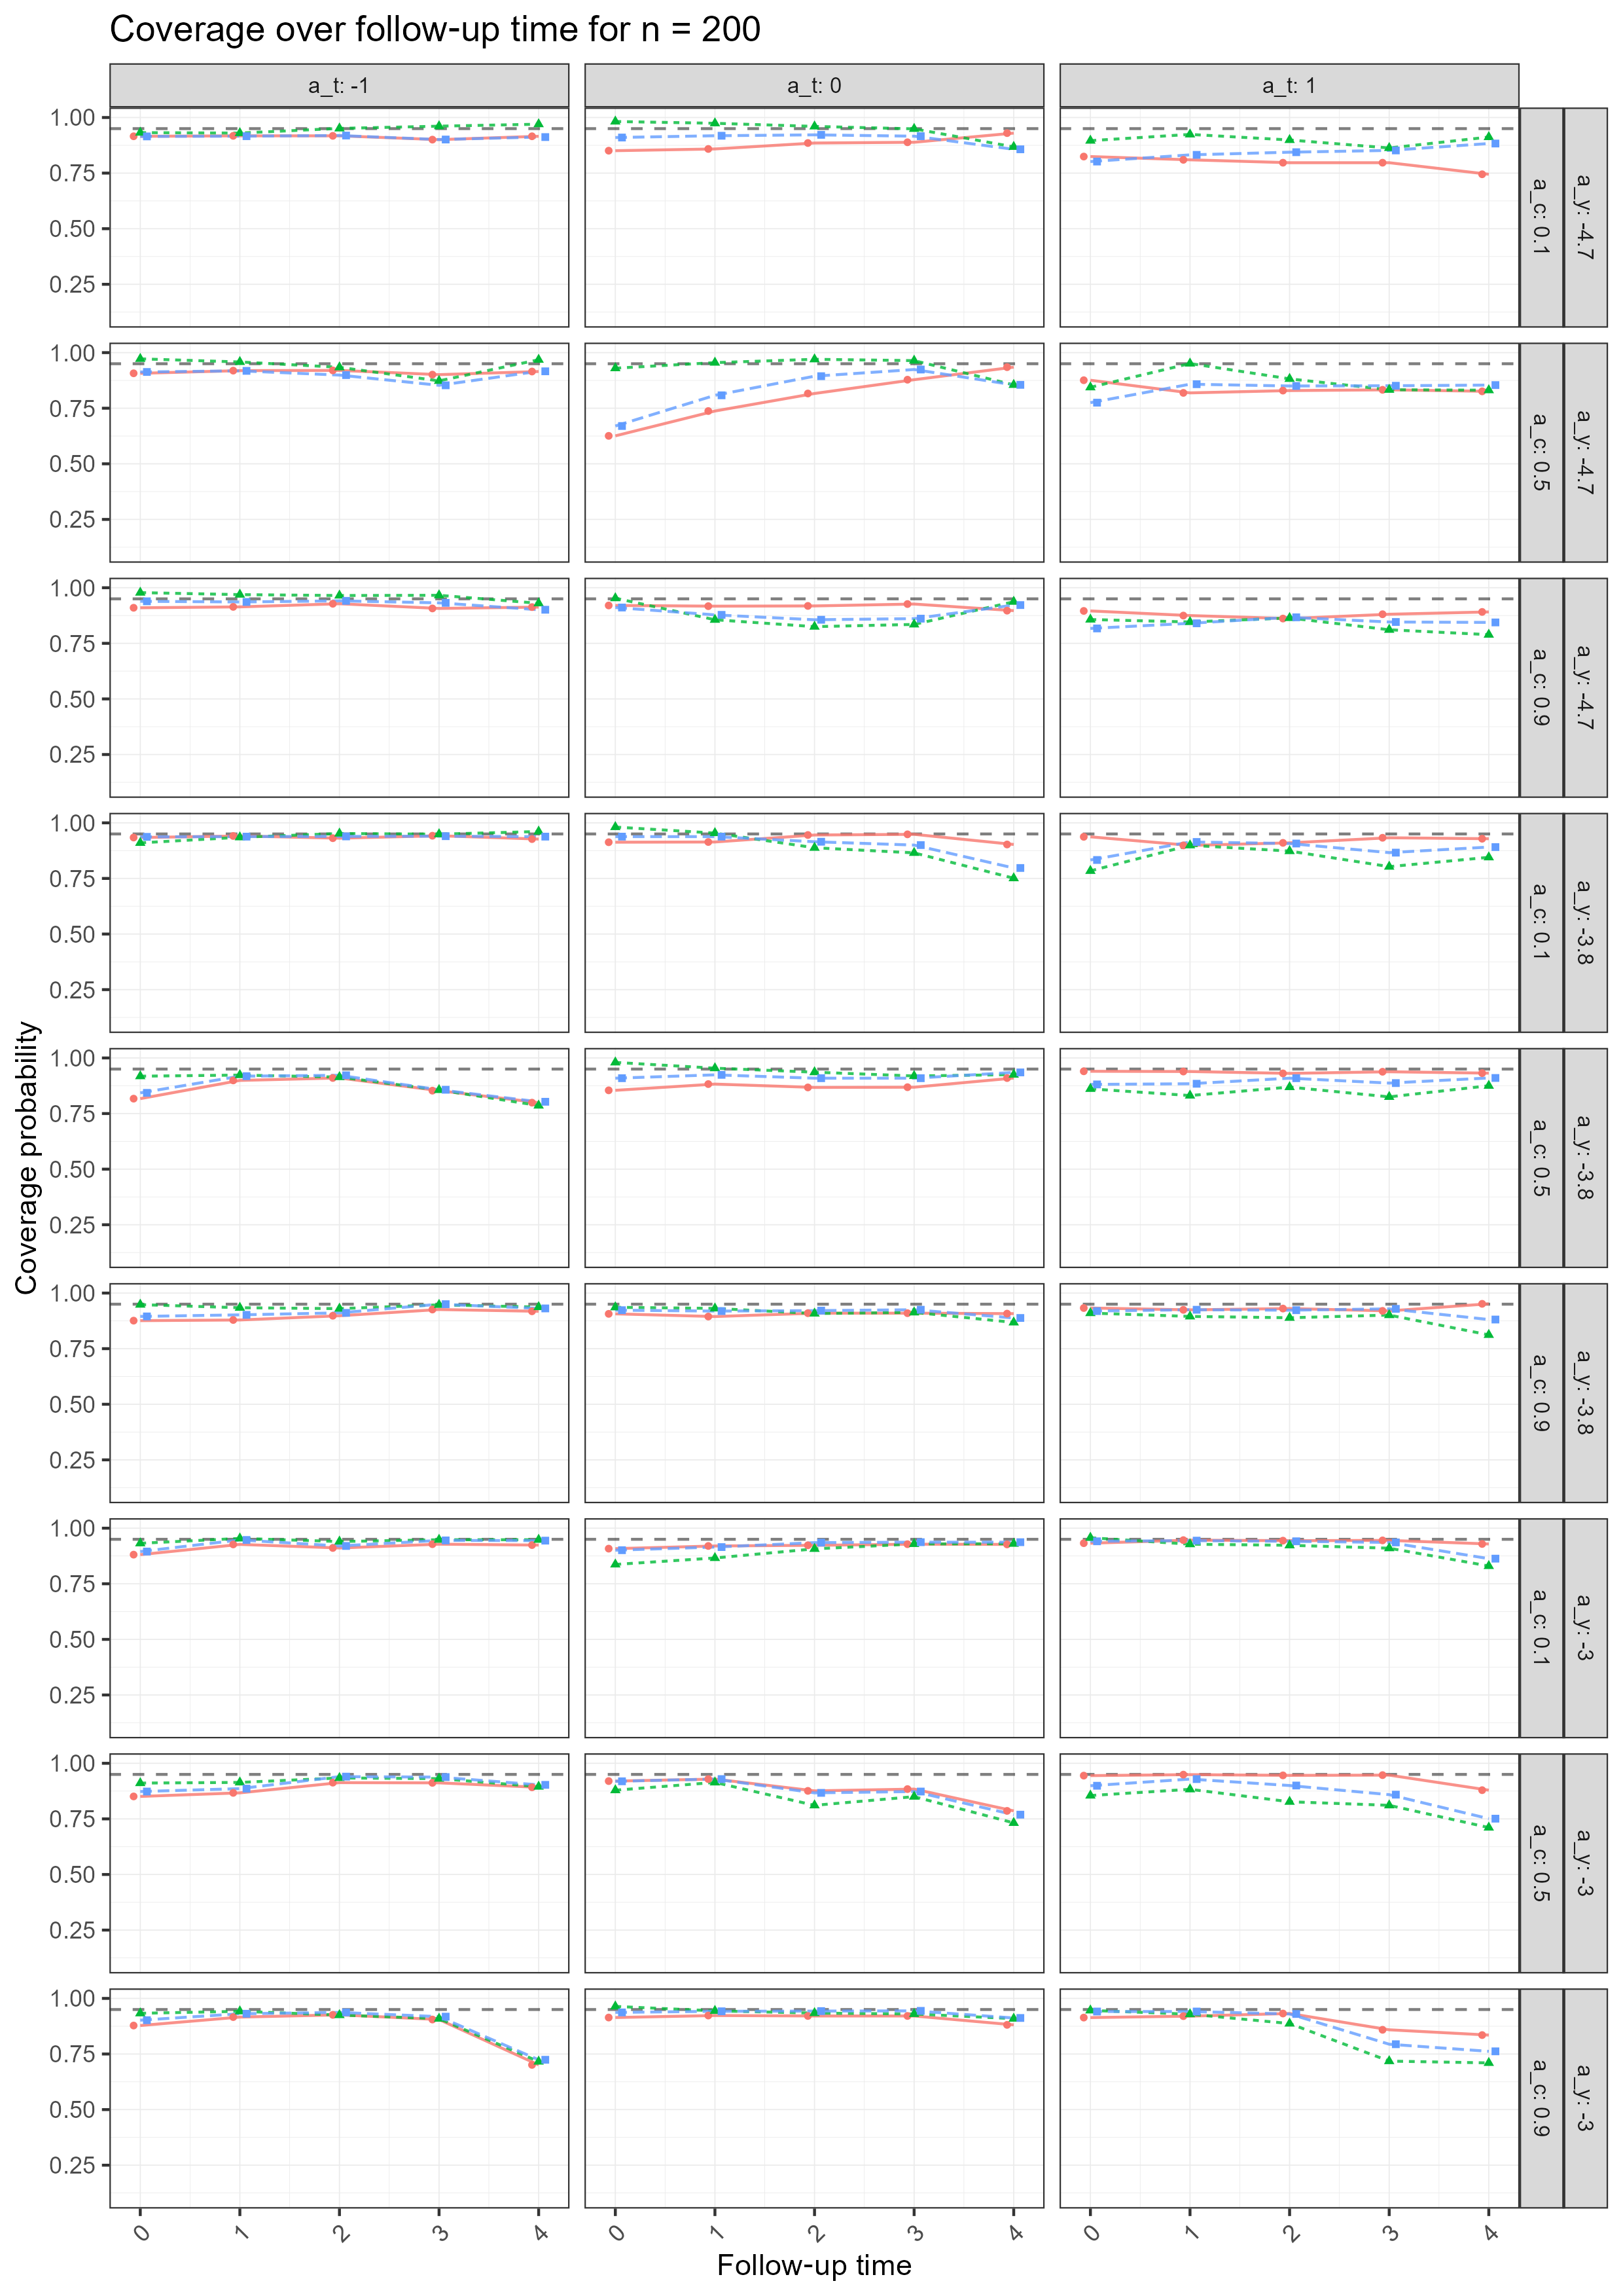
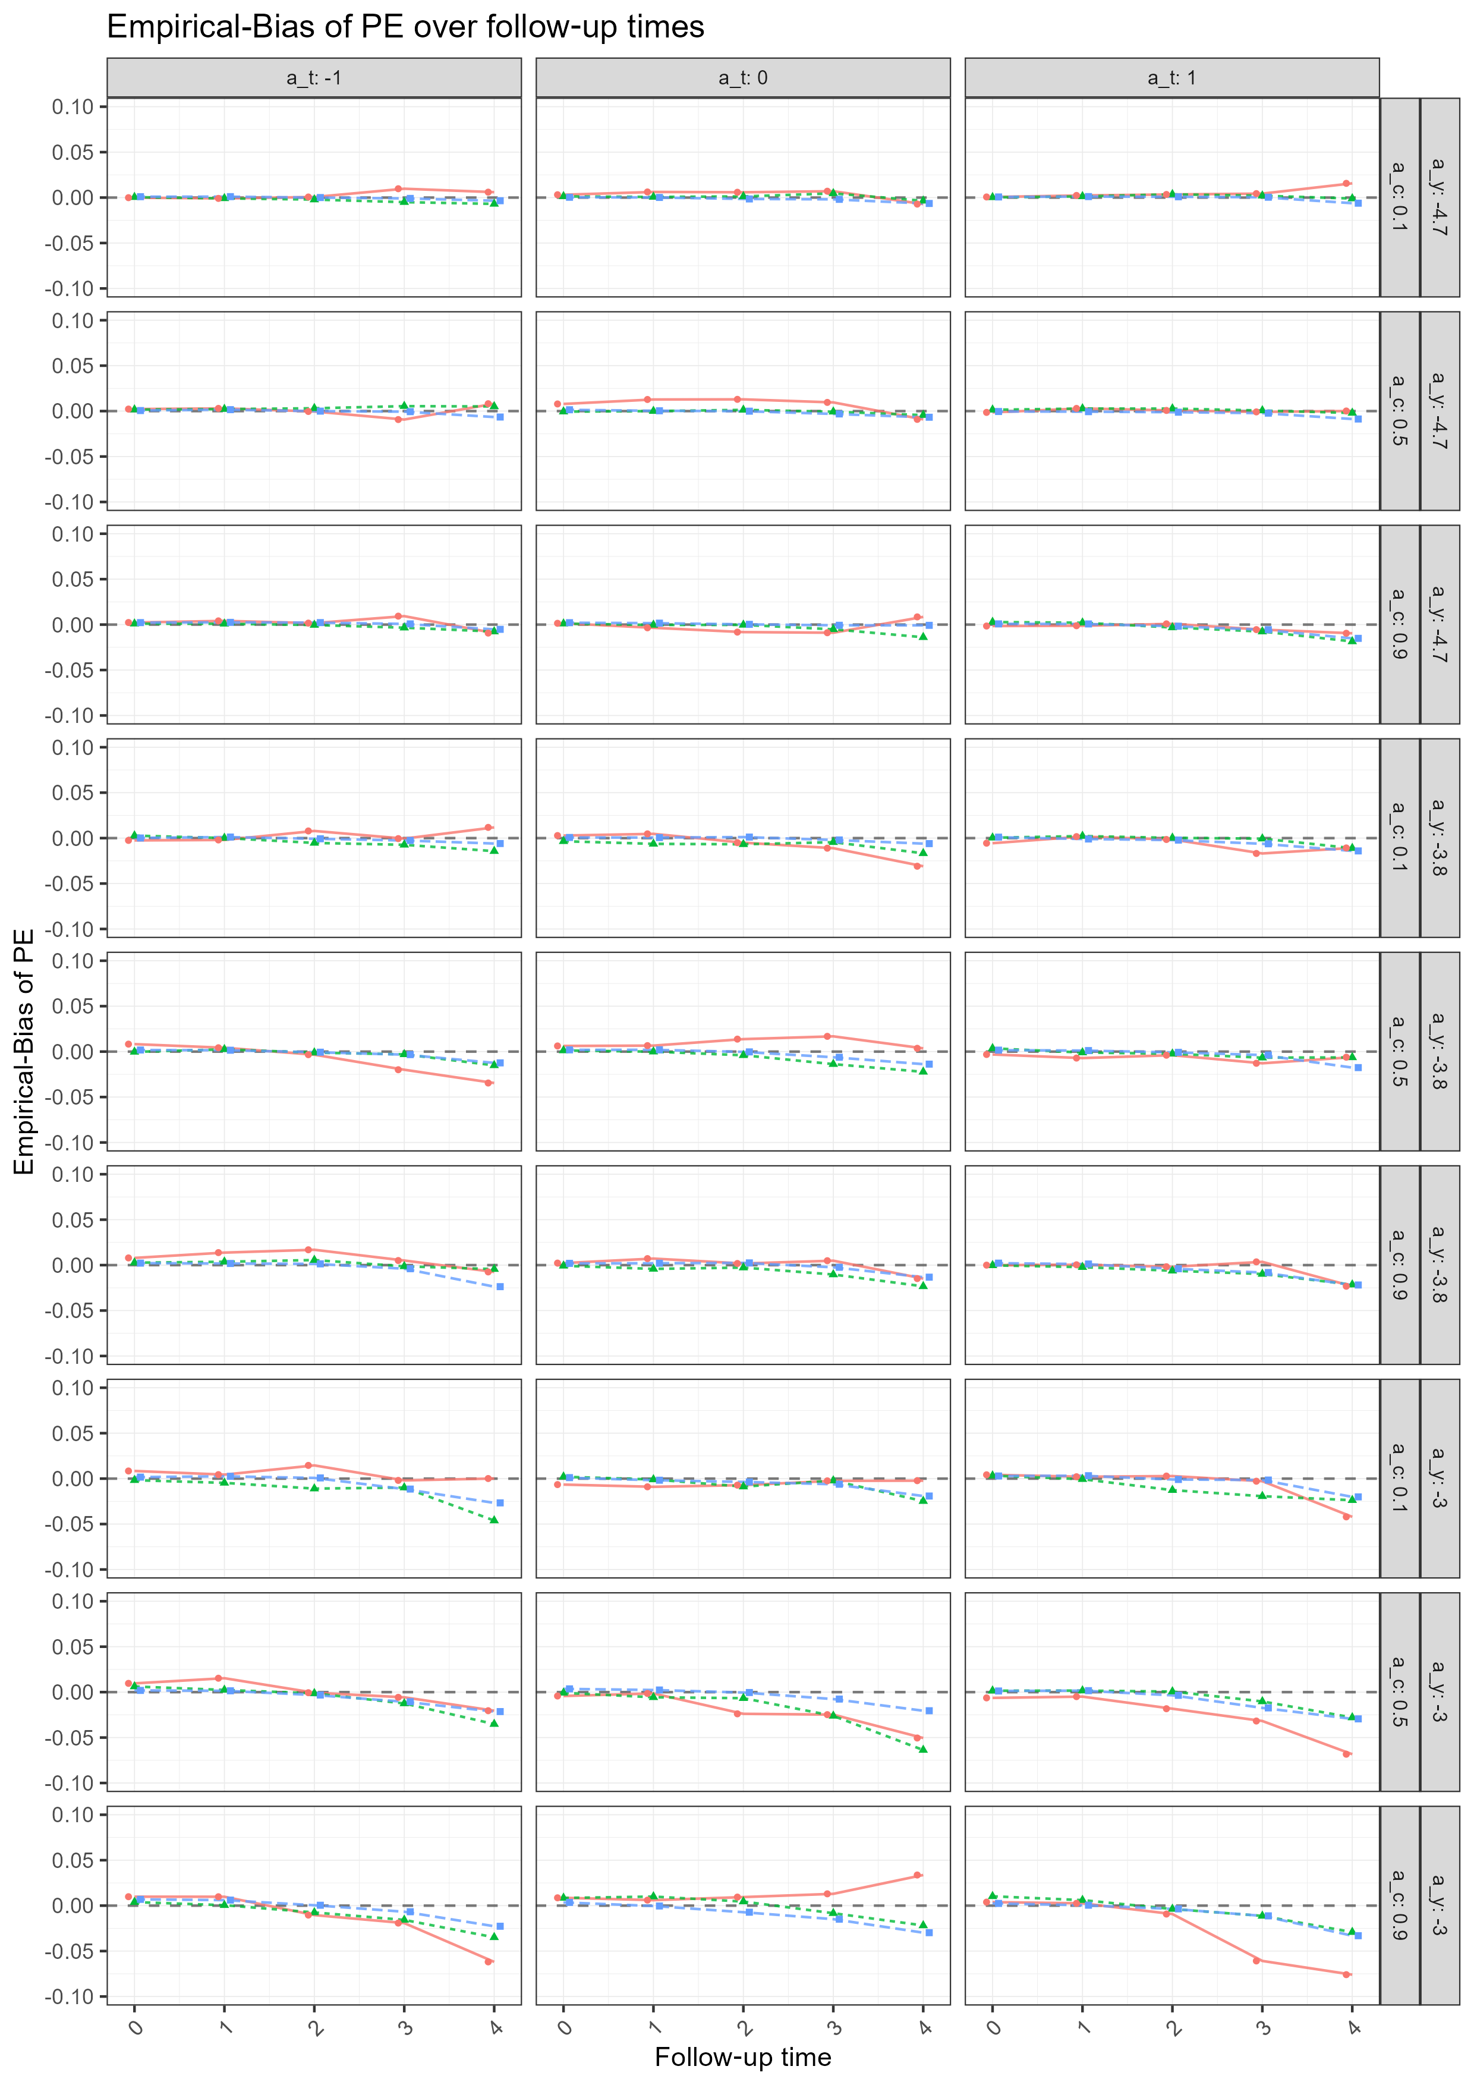
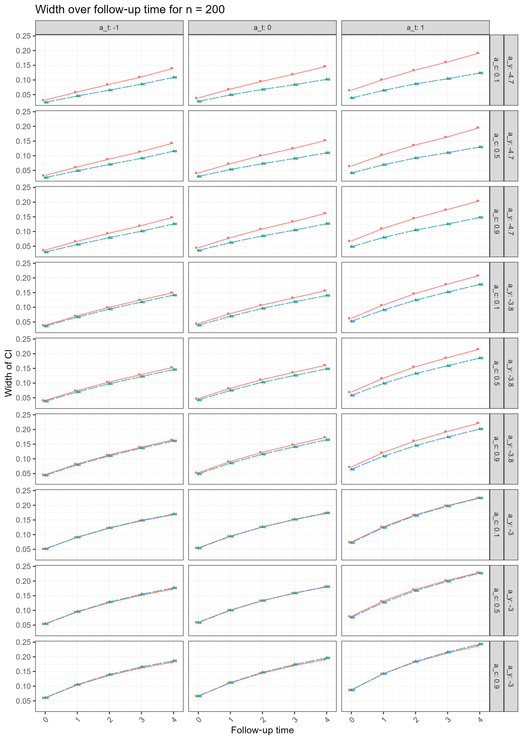
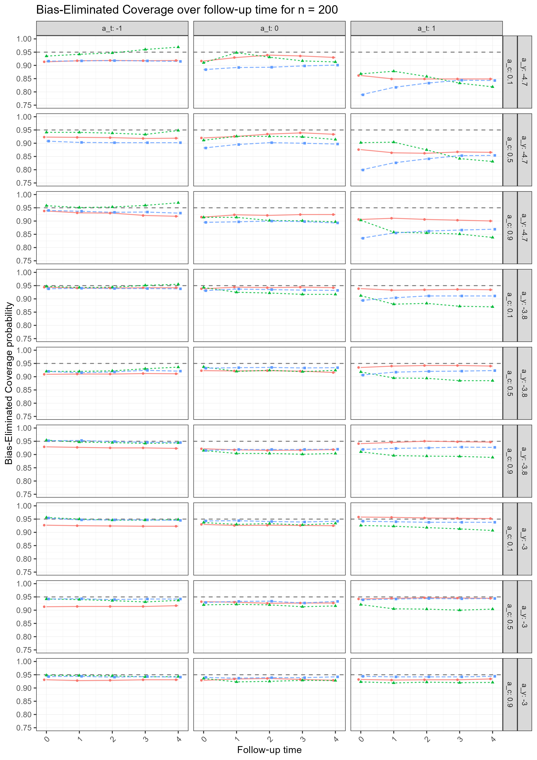

Improving Causal Inference from Observational Data
A Comparative Analysis of Confidence Interval Methods in Sequential Target Trial Emulation
Florian Metwaly
Background
Sequential Target Trial Emulation (TTE) is a framework that is gaining popularity to estimate causal effects from observational data when a randomized control trial (RCT) is not feasible. As sequential TTE involves copying data from the observational dataset multiple times, the assumption of independence between observations is violated, and confidence intervals (CI) can no longer be estimated by standard estimation approaches. While sandwich-type estimators are commonly implemented in statistical software for CI estimation, the non-parametric bootstrap is the recommended method for CI estimation in the TTE literature. We compare the performance of the two approaches and present the Julia package TargetTrialEmulation.jl, for computationally efficient estimation of bootstrap CIs in the context of sequential TTE.
Results
Our simulation study finds that both bootstrap methods, percentile and empirical, more frequently achieved coverage closer to the nominal 95% level, particularly in small sample sizes, and produced narrower confidence intervals than the sandwich estimator. Although the sandwich-type estimator found consistently higher statistical power, this finding is most likely attributable to the sandwich-type estimator being biased upwards. Bias-eliminated coverage analysis suggested that coverage differences were primarily driven by bias in the point estimates, particularly at low event rates and later follow-up times.
Table 1
Od qui aute as moditaquiae qui adit periatent liquossequi con re doluptium aut et quos repere pera pa volorit omnihit
Title
Ut quam rem volupta eprovid quid quibus, quiatur aditatum est id quatus, tem ut etur restrum faccum sed et lautemqui sitatem. Em quas aut labore evellecae. Nam quia qui volut eium ne consendis porpore pro ente voluptatium ut iligendanda dolupta tquiat ommossi tatusdae con reste anderch iliquate odit, officaepe dusam, ium dero beatem eumqui acerupta qui nones aut veriam nonsere, occum que nimolup tatempor andaest es eaquidit laborere eum re, cor sanihic idebit landam voluptaqui opti reperatque qui ipsae sitam sedigenti blati acerspe rnatus, estinte dolendae et, volupta que earum esti omnia quaspicias di ad et rempore.
Figure 2
Coverage of the 95% confidence interval over 1000 simulations with sample size n = 200. The green line denotes the empirical bootstrap CI, the blue line denotes percentile bootstrap CI, and the red line denotes sandwich estimator CI. The dashed gray line marks 95%. The outcome event rate indicator is denoted by a_y, the confounding strength is denoted by a_c, and the treatment prevalence indicator is denoted by a_t.
Printing
For the printing of a poster please contact our print vendor Canon.
More information: Email: uu@canon.nl
Figure 4
Bias of the MRD point estimates over 1000 simulations. The red line denotes the sample size n = 200, the green line denotes the sample size n = 1000, and the blue line denotes the sample size n = 5000. The dashed gray line marks the reference value 0. The outcome event rate indicator is denoted by a_y, the confounding strength is denoted by a_c, and the treatment prevalence indicator is denoted by a_t.
Size
The size of this scientific poster is A0-portrait (84 x 118,9 cm).
Columns
The poster layout may consist of two or three columns.
Ratio between text and image
Do not use too much text (maximum ± 650 words). Try to tell the scientific results in clear images (graphics, illustrations, photo’s).
Color
You can find the used colors in the menubar > Shape Fill > Theme colors, or in Recent colors.
Figure 1
Width of the 95% confidence interval over 1000 simulations with sample size n = 200. The green line denotes the empirical bootstrap CI, the blue line denotes percentile bootstrap CI, and the red line denotes sandwich estimator CI. The outcome event rate indicator is denoted by a_y, the confounding strength is denoted by a_c, and the treatment prevalence indicator is denoted by a_t.
Conclusion
While this study confirms bootstrap’s potential, limitations of the percentile and empirical approaches, such as sensitivity to skewed distributions and a biased estimator, suggest the need for more robust methods. Advanced techniques like the bias-corrected and accelerated (BCa) bootstrap may provide improved inference in complex TTE settings. Future work should focus on benchmarking these methods using the evaluation framework employed in this study, coverage, width, and bias-eliminated coverage. It should additionally incorporate assessments of power and type I error control, and further focus on computational efficiency.
Methods
In a simulation study, we compare the performance of the sandwich-type against two types of non-parametric bootstrap CI estimation: the percentile and the empirical bootstrap. We test the estimators across 81 scenarios, varying the sample sizes, confounding strength, outcome prevalence, and treatment prevalence. We compare their performance regarding their coverage, width, bias-eliminated coverage, and power.
Figure 3
Bias-eliminated coverage of the 95% confidence interval over 1000 simulations with sample size n = 200. The green line denotes the empirical bootstrap CI, the blue line denotes percentile bootstrap CI, and the red line denotes sandwich estimator CI. The dashed gray line marks 95%. The outcome event rate indicator is denoted by a_y, the confounding strength is denoted by a_c, and the treatment prevalence indicator is denoted by a_t.
f.j.metwaly@uu.nl
https://github.com/flo1met/thesis_TTE

